Slide 1
How is the First Process Created?
What happens when you turn on a computer?
How to get from raw hardware to the first running process, or process 1 under UNIX?
Well…it’s a long story…
  It starts with a simple computing machine

Slide 2

Long, Long, Long Ago…(during the 1940s)
John von Neumann invented von Neumann computer architecture
  A CPU
  A memory unit
  I/O devices (e.g.,
  disks and tapes)

Slide 3
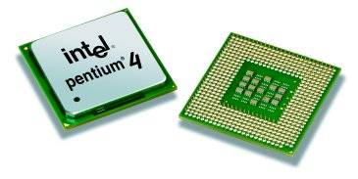
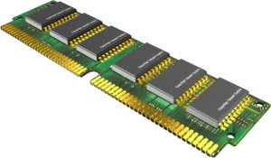
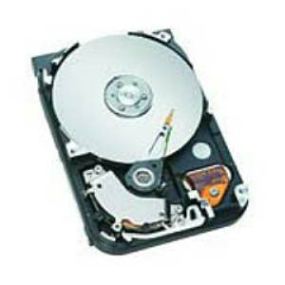
In von Neumann Architecture,
Programs are stored on storage devices
Programs are copied into memory for execution
CPU reads each instruction in the program and executes accordingly

Slide 4
A Simple CPU Model
Fetch-execute algorithm
During a boot sequence, the program counter (PC) is loaded with the address of the first instruction
The instruction register (IR) is loaded with the instruction from the address

Slide 5
Fetch-Execute Algorithm
PC = <address of the first instruction>
…
PC
3000
load r3, b
3000
load r4, c
3004
IR
load r3, b
…
Memory addresses

Slide 6
Fetch-Execute Algorithm
while (not halt) {
// increment PC
…
PC
3000
load r3, b
3000
load r4, c
3004
IR
load r3, b
…
Memory addresses

Slide 7
Fetch-Execute Algorithm
while (not halt) {
// increment PC
…
PC
3004
load r3, b
3000
// execute(IR)
load r4, c
3004
IR
load r3, b
…
// IR = memory
// content of PC
}
Memory addresses

Slide 8
Fetch-Execute Algorithm
while (not halt) {
// increment PC
…
PC
3004
load r3, b
3000
// execute(IR)
load r4, c
3004
IR
load r4, c
…
// IR = memory
// content of PC
}
Memory addresses

Slide 9
Booting Sequence
The address of the first instruction is fixed
It is stored in read-only-memory (ROM)

Slide 10
Booting Procedure for i386 Machines
On i386 machines, ROM stores a Basic Input/Output System (BIOS)
  BIOS contains information on how to access storage devices

Slide 11
BIOS Code
Performs Power-On Self Test (POST)
  Checks memory and devices for their presence and correct operations
  During this time, you will hear memory counting, which consists of noises from the floppy and hard drive, followed by a final beep

Slide 12
After the POST
The master boot record (MBR) is loaded from the boot device (configured in BIOS)
The MBR is stored at the first logical sector of the boot device (e.g., a hard drive) that
  Fits into a single 512-byte disk sector (boot sector)
  Describes the physical layout of the disk (e.g., number of tracks)

Slide 13
After Getting the Info on the Boot Device
BIOS loads a more sophisticated loader from other sectors on disk
The more sophisticated loader loads the operating system

Slide 14
Operating System Loaders
Under Linux, this sophisticated loader is called LILO (Linux Loader)
  It has nothing to do with Lilo and Stitch

Slide 15
More on OS Loaders
LILO
  Is partly stored in MBR with
  the disk partition table
    A user can specify which disk
    partition and OS image to
    boot
    Windows loader assumes only one bootable disk partition
  After loading the kernel image, LILO sets the kernel mode and jumps to the entry point of an operating system

Slide 16
Booting Sequence in Brief
A CPU jumps to a fixed address in ROM,
Loads the BIOS,
Performs POST,
Loads MBR from the boot device,
Loads an OS loader,
Loads the kernel image,
Sets the kernel mode, and
Jumps to the OS entry point.

Slide 17
Linux Initialization
Set up a number of things:
  Trap table
  Interrupt handlers
  Scheduler
  Clock
  Kernel modules
  …
  Process manager

Slide 18
Process 1
Is instantiated from the init program
Is the ancestor of all processes
Controls transitions between runlevels
Executes startup and shutdown scripts for each runlevel

Slide 19
Runlevels
Level 0: shutdown
Level 1: single-user
Level 2: multi-user (without network file system)
Level 3: full multi-user
Level 5: X11
Level 6: reboot

Slide 20
Process Creation
Via the fork system call family
Before we discuss process creation, a few words on system calls…

Slide 21
System Calls
System calls allow processes running at the user mode to access kernel functions that run under the kernel mode
Prevent processes from doing bad things, such as
  Halting the entire operating system
  Modifying the MBR

Slide 22
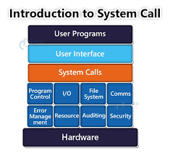

Slide 23
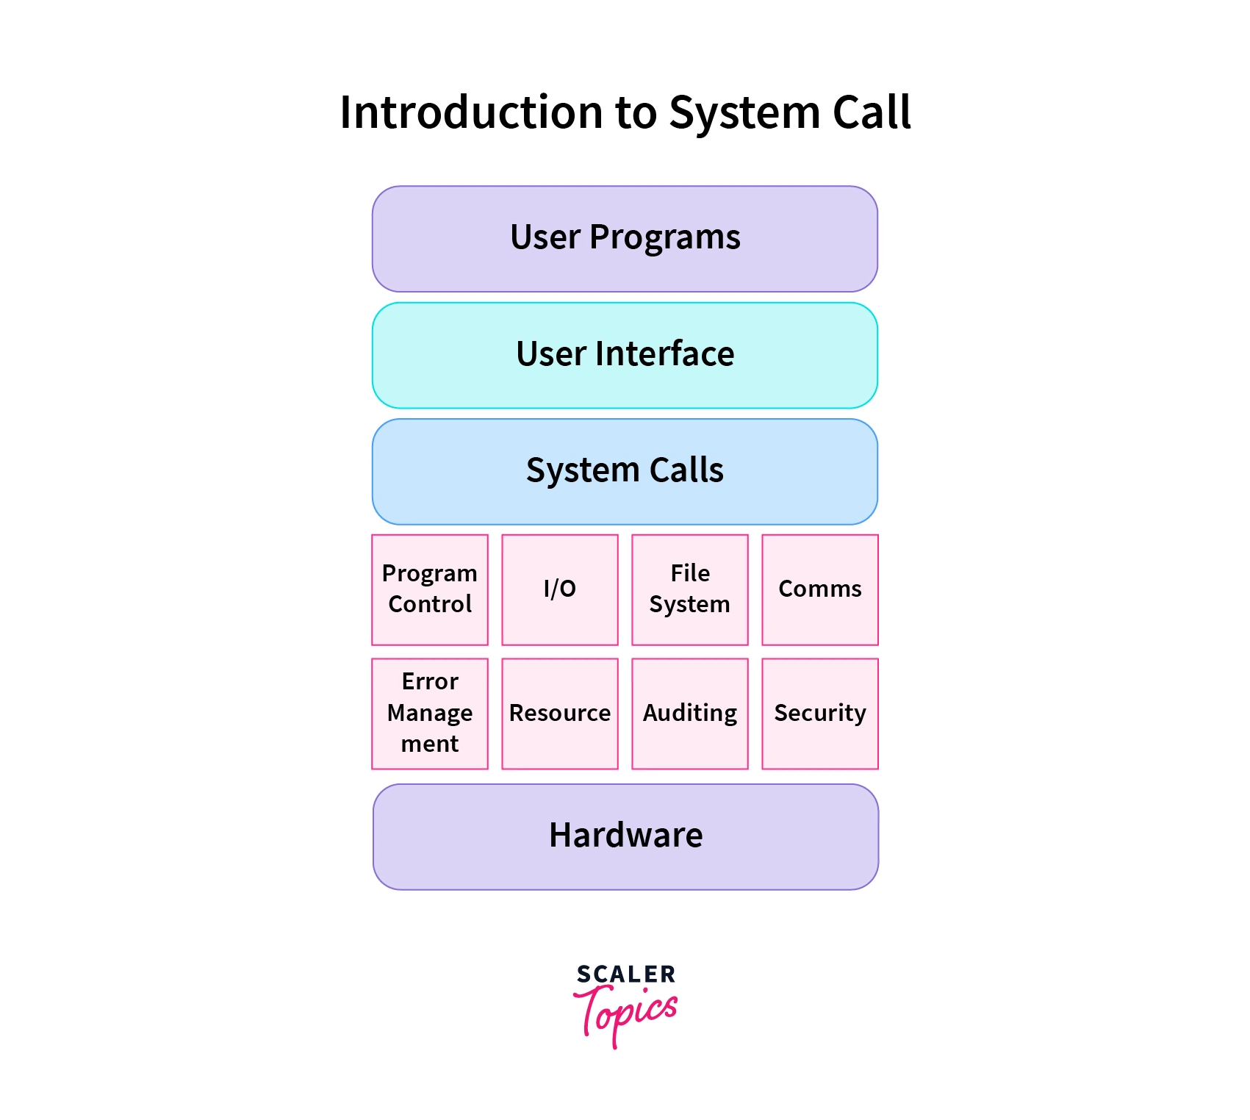

Slide 24
System Calls
Serve as an entry point to OS code
Allows users to request OS services
API’s/library functions usually provide an interface to system calls
  e.g, language-level I/O functions map user parameters into system-call format
Thus, the run-time support system of a prog. language acts as an interface between programmer and OS interface

Slide 25
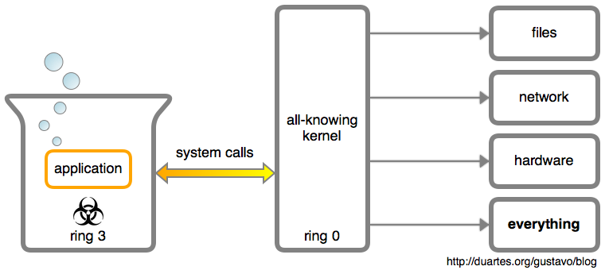

Slide 26
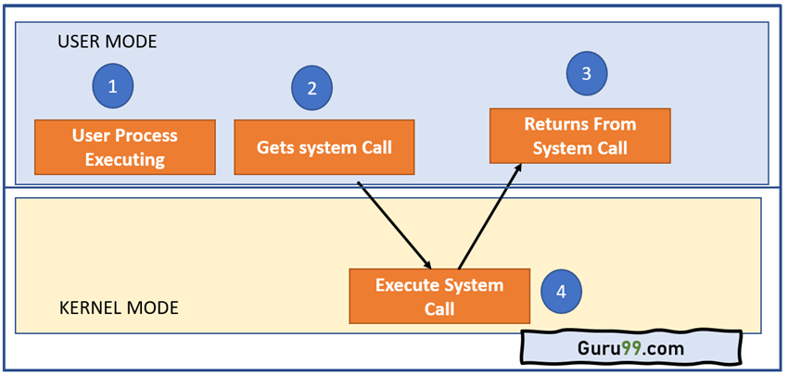

Slide 27

Some UNIX System Calls
System calls for low level file I/O
  creat(name, permissions)
  open(name, mode)
  close(fd)
  unlink(fd)
  read(fd, buffer, n_to_read)
  write(fd, buffer, n_to_write)
  lseek(fd, offest, whence)
System Calls for process control
  fork()
  wait()
  execl(), execlp(), execv(), execvp()
  exit()
  signal(sig, handler)
  kill(sig, pid)
System Calls for IPC
  pipe(fildes)
  dup(fd)

Slide 28
Execution Modes
(Dual Mode Execution)
User mode vs. kernel (or supervisor) mode
Protection mechanism: critical operations can only be performed by the OS while executing in kernel mode, (e.g. direct device access, enabling/disabling interrupts)
Mode bit – tells the current state of system
Privileged instructions → Kernel instructions

Slide 29
Mode Switching (maybe RHA)
System calls allow boundary to be crossed
  System call initiates mode switch from user to kernel mode
    User Mode → Kernel Mode
  Special instruction – “software interrupt” – calls the kernel function
    transfers control to a location in the interrupt vector table
  OS executes kernel code, mode switch occurs again when control returns to user process

Slide 30
Processing a System Call*
Switching between kernel and user mode is time consuming
Kernel must
  Save registers so the executing process can resume execution
    Other overhead is involved; e.g. cache misses, & prefetch
  Verify system call name and parameters
  Call the kernel function to perform the service
  On completion, restore registers and return to caller

Slide 31

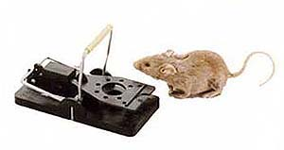
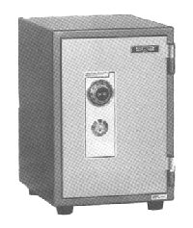
UNIX System Calls
Implemented through the trap instruction
trap
set kernel mode
branch table
trusted code

Slide 32
Assignment-1
Two C-based programs
Nag.c (demonstrating fork() system call)
Hungryeyes.c (demonstrating execvp() system call)
To be implemented in C under Linux environment
→ Pay attention to understand

Slide 33
A fork Example, Nag.c
#include <stdio.h>
#include <unistd.h>
#include <sys/types.h>
int main() {
pid_t pid;
if ((pid = fork()) == 0) {
while (1) {
printf(“child’s return value %d: I want to play…\n”, pid);
}
} else {
while (1) {
printf(“parent’s return value %d: After the project…\n”, pid);
}
}
return 0;
}
Parent process

Slide 34
A fork Example, Nag.c
#include <stdio.h>
#include <unistd.h>
#include <sys/types.h>
int main() {
pid_t pid;
if ((pid = fork()) == 0) {
while (1) {
printf(“child’s return value %d: I want to play…\n”, pid);
}
} else {
while (1) {
printf(“parent’s return value %d: After the project…\n”, pid);
}
}
return 0;
}
Parent process

Slide 35
A fork Example, Nag.c
#include <stdio.h>
#include <unistd.h>
#include <sys/types.h>
int main() {
pid_t pid;
if ((pid = fork()) == 0) {
while (1) {
printf(“child’s return value %d: I want to play…\n”, pid);
}
} else {
while (1) {
printf(“parent’s return value %d: After the project…\n”, pid);
}
}
return 0;
}
#include <stdio.h>
#include <unistd.h>
#include <sys/types.h>
int main() {
pid_t pid;
if ((pid = fork()) == 0) {
while (1) {
printf(“child’s return value %d: I want to play…\n”, pid);
}
} else {
while (1) {
printf(“parent’s return value %d: After the project…\n”, pid);
}
}
return 0;
}
Parent process
Child process

Slide 36
A fork Example, Nag.c
#include <stdio.h>
#include <unistd.h>
#include <sys/types.h>
int main() {
pid_t pid;
if ((pid = 3128) == 0) {
while (1) {
printf(“child’s return value %d: I want to play…\n”, pid);
}
} else {
while (1) {
printf(“parent’s return value %d: After the project…\n”, pid);
}
}
return 0;
}
#include <stdio.h>
#include <unistd.h>
#include <sys/types.h>
int main() {
pid_t pid;
if ((pid = 0) == 0) {
while (1) {
printf(“child’s return value %d: I want to play…\n”, pid);
}
} else {
while (1) {
printf(“parent’s return value %d: After the project…\n”, pid);
}
}
return 0;
}
Parent process
Child process

Slide 37
A fork Example, Nag.c
#include <stdio.h>
#include <unistd.h>
#include <sys/types.h>
int main() {
pid_t pid;
if ((pid = 3128) == 0) {
while (1) {
printf(“child’s return value %d: I want to play…\n”, pid);
}
} else {
while (1) {
printf(“parent’s return value %d: After the project…\n”, pid);
}
}
return 0;
}
#include <stdio.h>
#include <unistd.h>
#include <sys/types.h>
int main() {
pid_t pid;
if ((pid = 0) == 0) {
while (1) {
printf(“child’s return value %d: I want to play…\n”, pid);
}
} else {
while (1) {
printf(“parent’s return value %d: After the project…\n”, pid);
}
}
return 0;
}
Parent process
Child process

Slide 38
Nag.c Outputs
>a.out
child’s return value 0: I want to play…
child’s return value 0: I want to play…
child’s return value 0: I want to play…
…// context switch
parent’s return value 3218: After the project…
parent’s return value 3218: After the project…
parent’s return value 3218: After the project…
…// context switch
child’s return value 0: I want to play…
child’s return value 0: I want to play…
child’s return value 0: I want to play…
^C
>

Slide 39
The exec System Call Family
A fork by itself is not interesting
To make a process run a program that is different from the parent process, you need exec system call
exec starts a program by overwriting the current process

Slide 40
A exec Example, HungryEyes.c
#include <stdio.h>
#include <unistd.h>
#include <sys/types.h>
#define LB_SIZE 1024
int main(int argc, char *argv[]) {
char fullPathName[] = “/usr/X11R6/bin/xeyes”;
char *myArgv[LB_SIZE]; // an array of pointers
myArgv[0] = (char *) malloc(strlen(fullPathName) + 1);
strcpy(myArgv[0], fullPathName);
myArgv[1] = NULL; // last element should be a NULL pointer
execvp(fullPathName, myArgv);
exit(0); // should not be reached
}
At a shell prompt:
>whereis xeyes
/usr/X11R6/bin/xeyes
A process

Slide 41
A exec Example, HungryEyes.c
#include <stdio.h>
#include <unistd.h>
#include <sys/types.h>
#define LB_SIZE 1024
int main(int argc, char *argv[]) {
char fullPathName[] = “/usr/X11R6/bin/xeyes”;
char *myArgv[LB_SIZE]; // an array of pointers
myArgv[0] = (char *) malloc(strlen(fullPathName) + 1);
strcpy(myArgv[0], fullPathName);
myArgv[1] = NULL; // last element should be a NULL pointer
execvp(fullPathName, myArgv);
exit(0); // should not be reached
}
A process

Slide 42
A exec Example, HungryEyes.c
#include <stdio.h>
#include <unistd.h>
#include <sys/types.h>
#define LB_SIZE 1024
int main(int argc, char *argv[]) {
char fullPathName[] = “/usr/X11R6/bin/xeyes”;
char *myArgv[LB_SIZE]; // an array of pointers
myArgv[0] = (char *) malloc(strlen(fullPathName) + 1);
strcpy(myArgv[0], fullPathName);
myArgv[1] = NULL; // last element should be a NULL pointer
execvp(fullPathName, myArgv);
exit(0); // should not be reached
}
A process

Slide 43
A exec Example, HungryEyes.c
#include <stdio.h>
#include <unistd.h>
#include <sys/types.h>
#define LB_SIZE 1024
int main(int argc, char *argv[]) {
char fullPathName[] = “/usr/X11R6/bin/xeyes”;
char *myArgv[LB_SIZE]; // an array of pointers
myArgv[0] = (char *) malloc(strlen(fullPathName) + 1);
strcpy(myArgv[0], fullPathName);
myArgv[1] = NULL; // last element should be a NULL pointer
execvp(fullPathName, myArgv);
exit(0); // should not be reached
}
A process

Slide 44
A exec Example, HungryEyes.c
#include <stdio.h>
#include <unistd.h>
#include <sys/types.h>
#define LB_SIZE 1024
int main(int argc, char *argv[]) {
char fullPathName[] = “/usr/X11R6/bin/xeyes”;
char *myArgv[LB_SIZE]; // an array of pointers
myArgv[0] = (char *) malloc(strlen(fullPathName) + 1);
strcpy(myArgv[0], fullPathName);
myArgv[1] = NULL; // last element should be a NULL pointer
execvp(fullPathName, myArgv);
exit(0); // should not be reached
}
A process

Slide 45
A exec Example, HungryEyes.c
#include <stdio.h>
#include <unistd.h>
#include <sys/types.h>
#define LB_SIZE 1024
int main(int argc, char *argv[]) {
char fullPathName[] = “/usr/X11R6/bin/xeyes”;
char *myArgv[LB_SIZE]; // an array of pointers
myArgv[0] = (char *) malloc(strlen(fullPathName) + 1);
strcpy(myArgv[0], fullPathName);
myArgv[1] = NULL; // last element should be a NULL pointer
execvp(fullPathName, myArgv);
exit(0); // should not be reached
}
A process

Slide 46
A exec Example, HungryEyes.c
#include <stdio.h>
#include <unistd.h>
#include <sys/types.h>
#define LB_SIZE 1024
int main(int argc, char *argv[]) {
char fullPathName[] = “/usr/X11R6/bin/xeyes”;
char *myArgv[LB_SIZE]; // an array of pointers
myArgv[0] = (char *) malloc(strlen(fullPathName) + 1);
strcpy(myArgv[0], fullPathName);
myArgv[1] = NULL; // last element should be a NULL pointer
execvp(fullPathName, myArgv);
exit(0); // should not be reached
}
A process

Slide 47
A exec Example, HungryEyes.c
#include <stdio.h>
#include <unistd.h>
#include <sys/types.h>
#define LB_SIZE 1024
int main(int argc, char *argv[]) {
char fullPathName[] = “/usr/X11R6/bin/xeyes”;
char *myArgv[LB_SIZE]; // an array of pointers
myArgv[0] = (char *) malloc(strlen(fullPathName) + 1);
strcpy(myArgv[0], fullPathName);
myArgv[1] = NULL; // last element should be a NULL pointer
execvp(fullPathName, myArgv);
exit(0); // should not be reached
}
A process

Slide 48
A exec Example, HungryEyes.c
#include <stdio.h>
#include <unistd.h>
#include <sys/types.h>
#define LB_SIZE 1024
int main(int argc, char *argv[]) {
char fullPathName[] = “/usr/X11R6/bin/xeyes”;
char *myArgv[LB_SIZE]; // an array of pointers
myArgv[0] = (char *) malloc(strlen(fullPathName) + 1);
strcpy(myArgv[0], fullPathName);
myArgv[1] = NULL; // last element should be a NULL pointer
execvp(fullPathName, myArgv);
exit(0); // should not be reached
}
A process

Slide 49
Thread Creation
Use pthread_create() instead of fork()
A newly created thread will share the address space of the current process and all resources (e.g., open files)
+ Efficient sharing of states
- Potential corruptions by a misbehaving thread

Slide 50
Thread Creation
A simple C program that demonstrates the usage of pthread_create() to create a new thread under the Linux environment:
#include <stdio.h>
#include <stdlib.h>
#include <pthread.h>
// Function executed by the new thread
void *thread_function(void *arg) {
printf("This is the new thread.\n");
printf("Argument passed to the thread: %s\n", (char *)arg);
pthread_exit(NULL);
}
int main() {
pthread_t tid; // Thread ID
char *message = "Hello from the main thread!"; // Message to pass to the new thread
// Create a new thread
if (pthread_create(&tid, NULL, thread_function, (void *)message) != 0) {
fprintf(stderr, "Error creating thread.\n");
return 1;
}

Slide 51
Thread Creation
printf("This is the main thread.\n");
// Wait for the new thread to finish
if (pthread_join(tid, NULL) != 0) {
fprintf(stderr, "Error joining thread.\n");
return 1;
}
printf("Main thread exiting.\n");
return 0;
}
```
This program creates a new thread using pthread_create() and passes a message to it. The main thread then continues its execution, while the new thread executes the function `thread_function()`. Finally, the main thread waits for the new thread to finish using pthread_join().

Slide 52
Thread Creation
Use pthread_create() instead of fork()
A newly created thread will share the address space of the current process and all resources (e.g., open files)
+ Efficient sharing of states
- Potential corruptions by a misbehaving thread

Slide 53
Assignment-2 (Thread Creation)
Description: You are required to implement a C program that performs matrix multiplication using multithreading. The program should take two input matrices from the user, perform multiplication using multiple threads, and output the resulting matrix.

